Slide 1
FET ( Field Effect Transistor)
Few important advantages of FET over conventional Transistors
Unipolar device i. e. operation depends on only one type of charge carriers (h or e)
Voltage controlled Device (gate voltage controls drain current)
Very high input impedance (≈10⁹-10¹² Ω)
Source and drain are interchangeable in most Low-frequency applications
Low Voltage Low Current Operation is possible (Low-power consumption)
Less Noisy as Compared to BJT
No minority carrier storage (Turn off is faster)
Self limiting device
Very small in size, occupies very small space in ICs
Low voltage low current operation is possible in MOSFETS
Zero temperature drift of out put is possiblek

Slide 2
Types of Field Effect Transistors
(The Classification)
        JFET
MOSFET (IGFET)
n-Channel JFET
p-Channel JFET
FET
Enhancement MOSFET
Depletion MOSFET
n-Channel EMOSFET
p-Channel EMOSFET
n-Channel DMOSFET
p-Channel DMOSFET

Slide 3
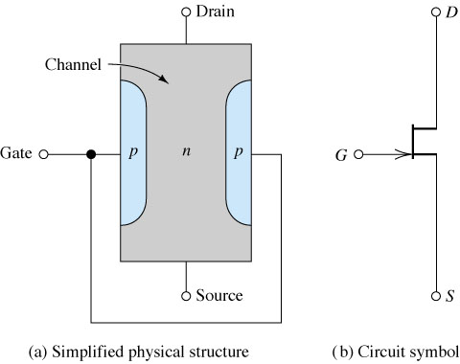
The Junction Field Effect Transistor (JFET)
Figure: n-Channel JFET.

Slide 4
SYMBOLS
Drain
Drain
Drain
Gate
Gate
Gate
Source
Source
Source
n-channel JFET
n-channel JFET
Offset-gate symbol
p-channel JFET

Slide 5
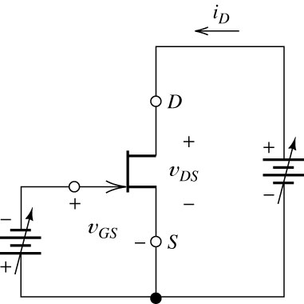
Biasing the JFET
Figure: n-Channel JFET and Biasing Circuit.

Slide 6
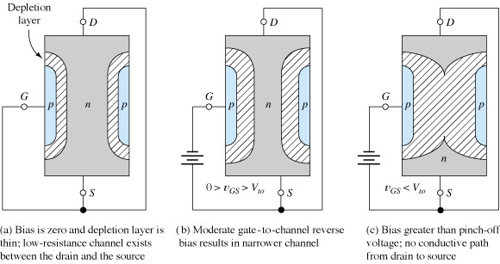
Operation of JFET at Various Gate Bias Potentials
Figure: The nonconductive depletion region becomes broader with increased reverse bias.
(Note: The two gate regions of each FET are connected to each other.)

Slide 7
Operation of a JFET
Drain
-
N
Gate
P
P
+
+
-
DC Voltage Source
-
N
+
Source

Slide 8
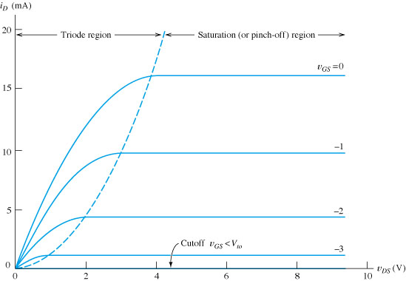
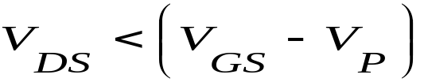
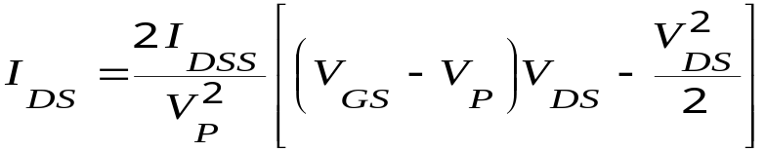
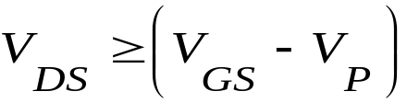
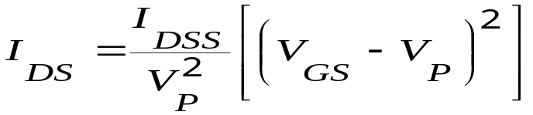
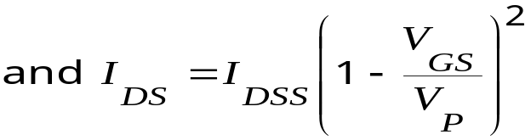
Output or Drain (V_{D}-I_{D}) Characteristics of n-JFET
Figure: Circuit for drain characteristics of the n-channel JFET and its Drain characteristics.
Non-saturation (Ohmic) Region:
The drain current is given by
Saturation (or Pinchoff) Region:
Where, I_{DSS} is the short circuit drain current, V_{P} is the pinch off voltage

Slide 9
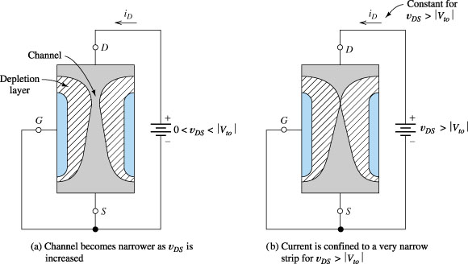
Simple Operation and Break down of n-Channel JFET
Figure: n-Channel FET for v_{GS} = 0.

Slide 10
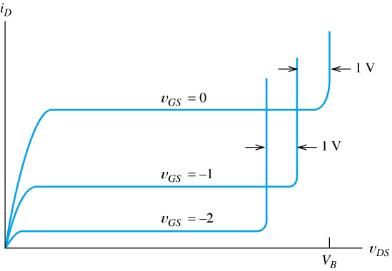
N-Channel JFET Characteristics and Breakdown
Break Down Region
Figure: If v_{DG} exceeds the breakdown voltage V_{B}, drain current increases rapidly.

Slide 11

V_{D}-I_{D} Characteristics of EMOS FET
Locus of pts where
Saturation or Pinch off Reg.
Figure: Typical drain characteristics of an n-channel JFET.

Slide 12
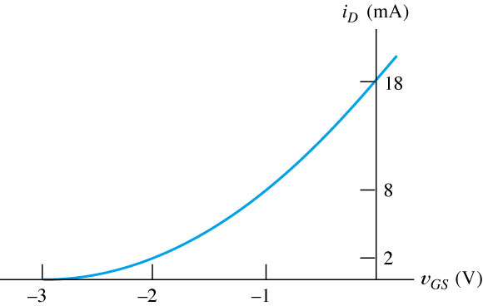
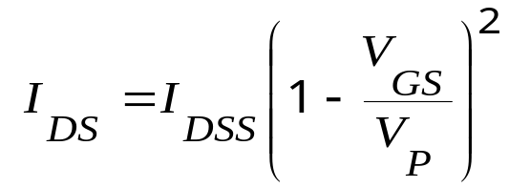
Transfer (Mutual) Characteristics of n-Channel JFET
I_{DSS}
V_{GS (off)}=V_{P}
Figure: Transfer (or Mutual) Characteristics of n-Channel JFET

Slide 13
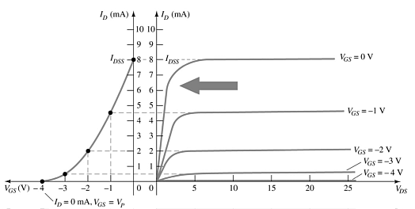
JFET Transfer Curve
This graph shows the value of I_{D} for a given value of V_{GS}

Slide 14
Biasing Circuits used for JFET
Fixed bias circuit
Self bias circuit
Potential Divider bias circuit

Slide 15
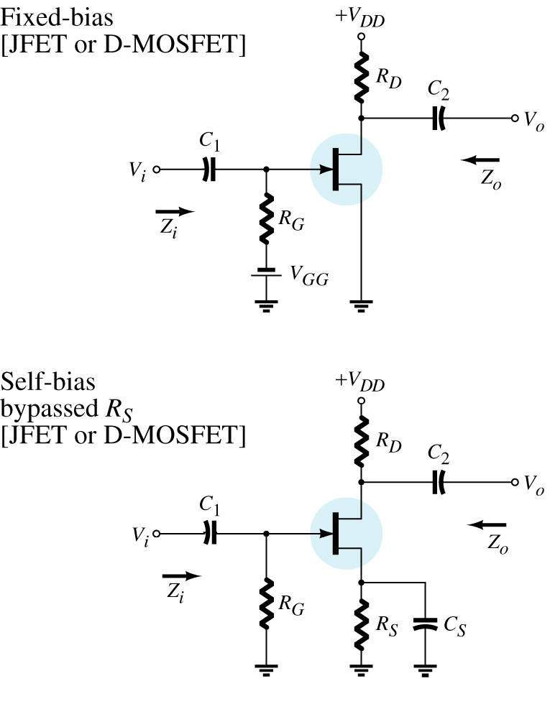
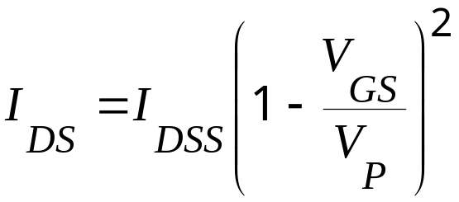
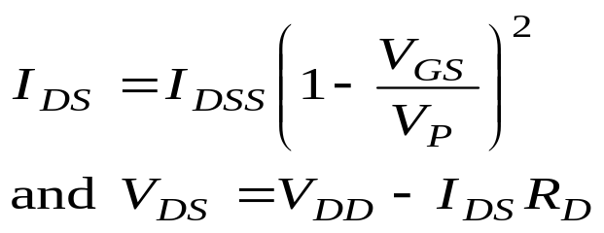
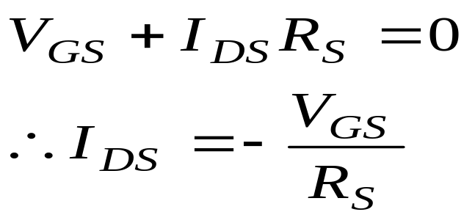
JFET (n-channel) Biasing Circuits
For Fixed Bias Circuit
Applying KVL to gate circuit we get
and
Where, V_{p}=V_{GS-off} & I_{DSS} is Short ckt. I_{DS}
For Self Bias Circuit

Slide 16
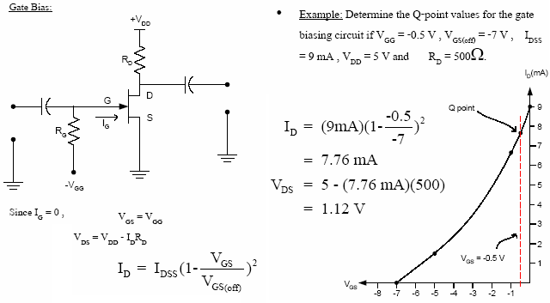
JFET Biasing Circuits Count…
or Fixed Bias Ckt.

Slide 17
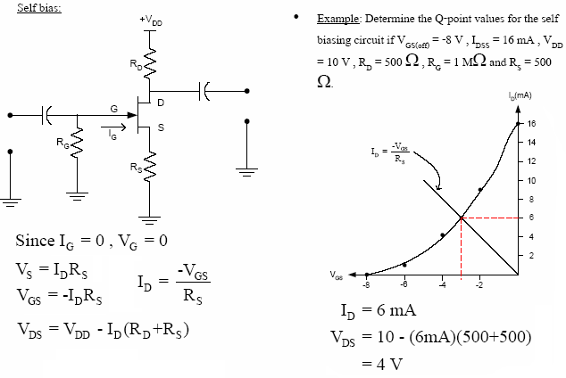
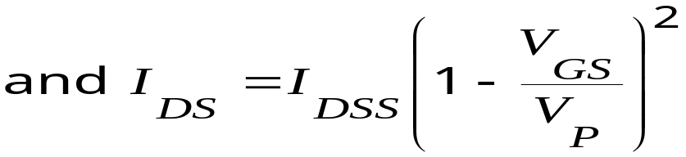
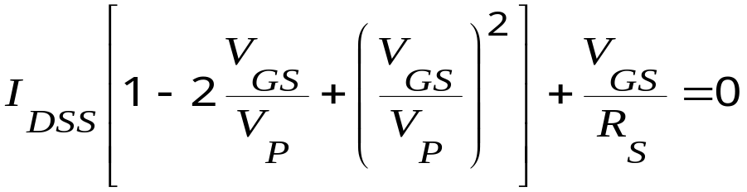
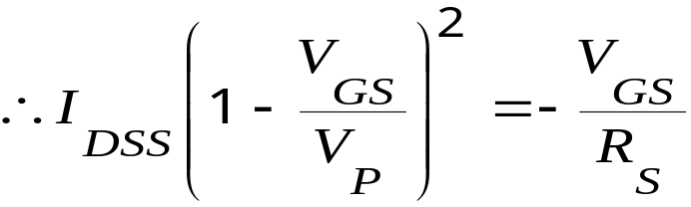
JFET Self (or Source) Bias Circuit
This quadratic equation can be solved for V_{GS} & I_{DS}

Slide 18
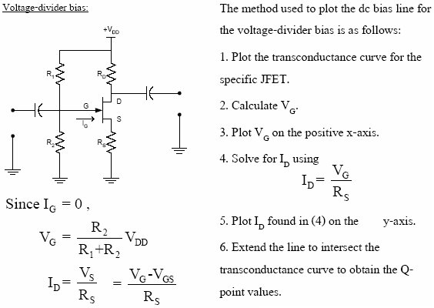
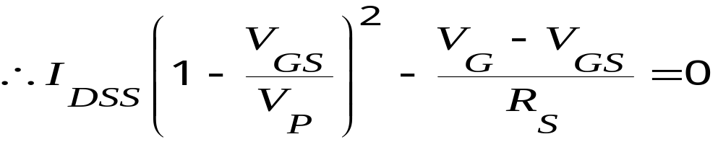
The Potential (Voltage) Divider Bias

Slide 19
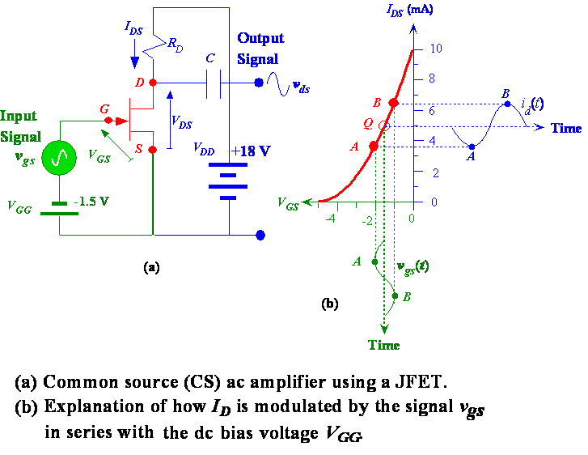
A Simple CS Amplifier and Variation in I_{DS} with V_{gs}

Slide 20
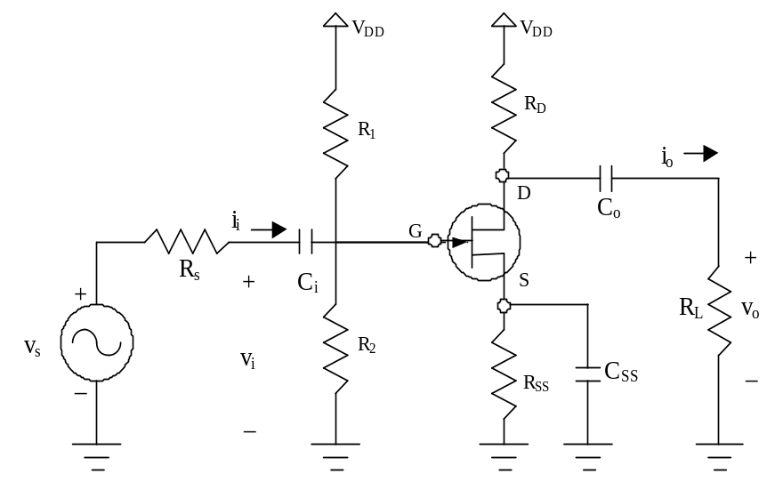
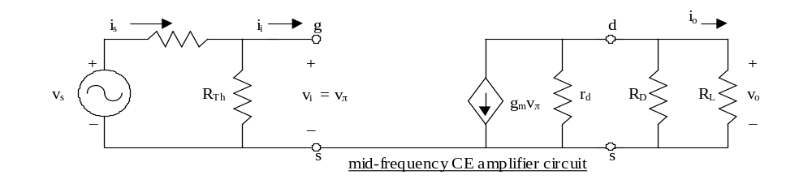
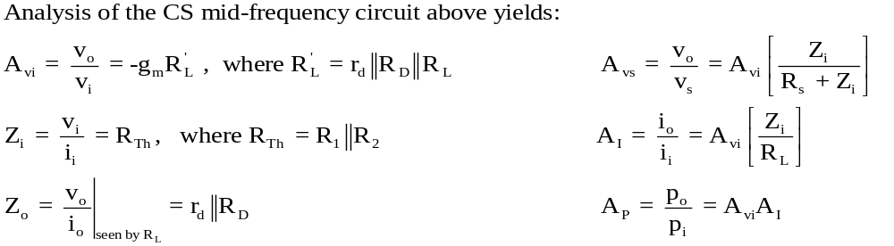
FET Mid-frequency Analysis:
A common source (CS) amplifier is shown to the right.
The mid-frequency circuit is drawn as follows:
the coupling capacitors (C_{i} and C_{o}) and the
bypass capacitor (C_{SS}) are short circuits
short the DC supply voltage (superposition)
replace the FET with the hybrid-π model
The resulting mid-frequency circuit is shown below.

Slide 21
FET Mid-frequency Analysis:
A common source (CS) amplifier is shown to the right.
The mid-frequency circuit is drawn as follows:
the coupling capacitors (C_{i} and C_{o}) and the
bypass capacitor (C_{SS}) are short circuits
short the DC supply voltage (superposition)
replace the FET with the hybrid-π model
The resulting mid-frequency circuit is shown below.

Slide 22
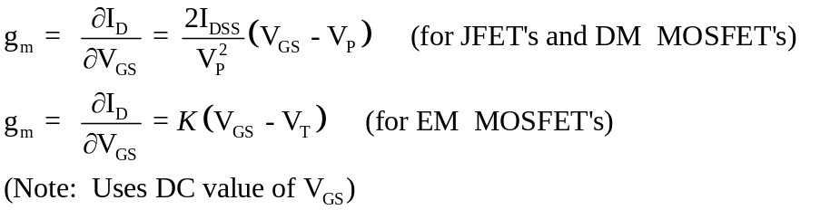
Procedure: Analysis of an FET amplifier at mid-frequency:
1) Find the DC Q-point. This will insure that the FET is operating in the saturation region and these values are needed for the next step.
2) Find g_{m}. If g_{m} is not specified, calculate it using the DC values of V_{GS} as follows:
3) Calculate the required values (typically A_{vi}, A_{vs}, A_{I}, A_{P}, Z_{i}, and Z_{o}. Use the formulas for the appropriate amplifier configuration (CS, CG, CD, etc).

Slide 23
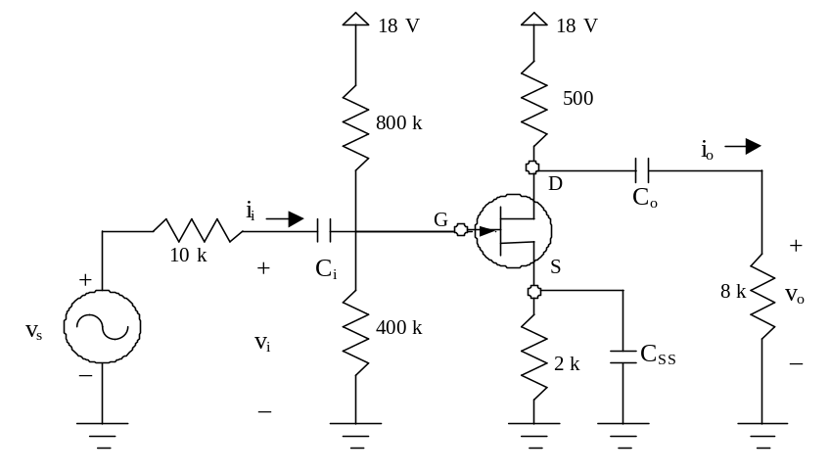
PE-Electrical Review Course - Class 4 (Transistors)
Example 7:
Find the mid-frequency values for A_{vi}, A_{vs}, A_{I}, A_{P}, Z_{i}, and Z_{o} for the amplifier shown below. Assume that C_{i}, C_{o}, and C_{SS} are large.
Note that this is the same biasing circuit used in Ex. 2, so V_{GS} = -0.178 V.
The JFET has the following specifications:
Ι_{DSS} = 4 mA, V_{P} = -1.46 V, r_{d} = 50 k

Slide 24
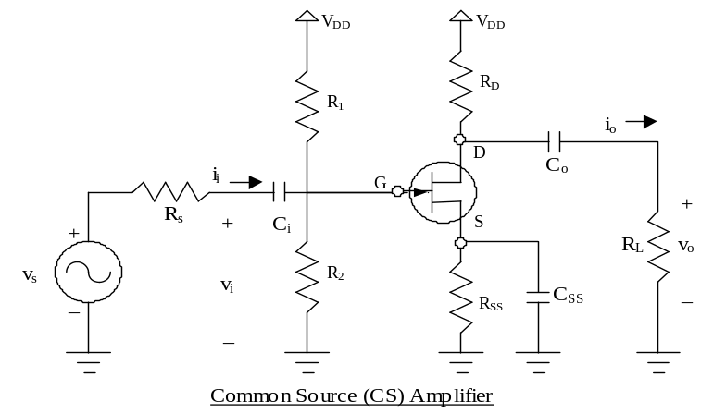
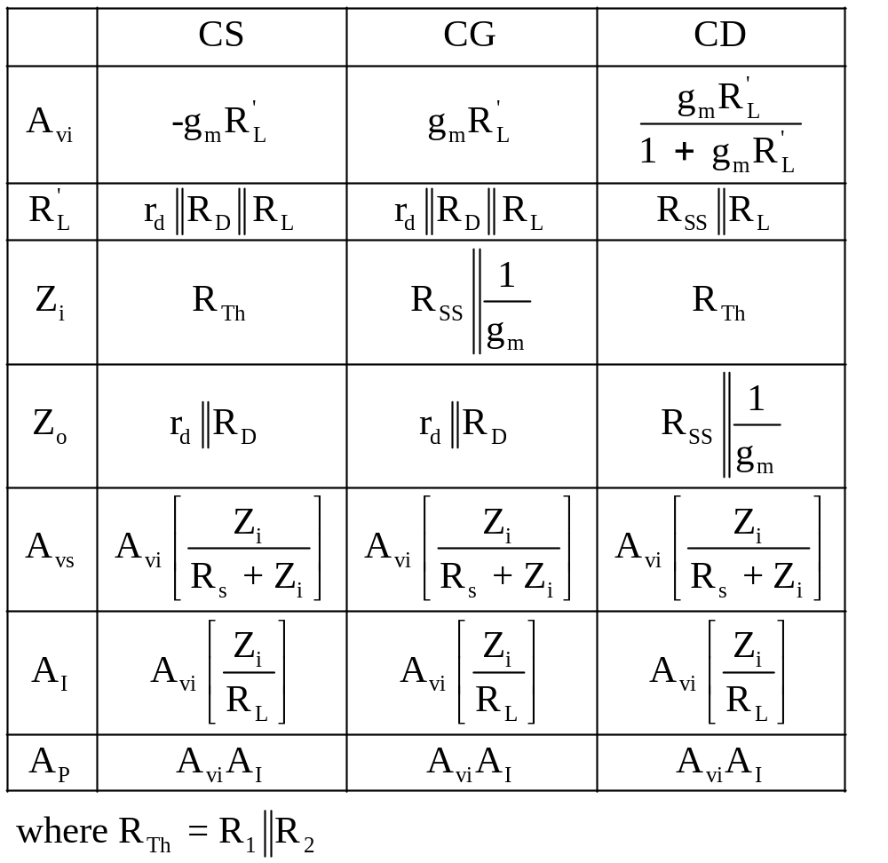
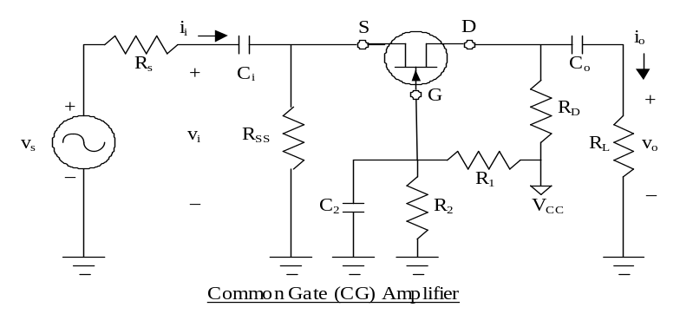
FET Amplifier Configurations and Relationships:
V
DD
V
DD
R
1
i
i
D
R
G
+
s
+
C
i
S
i
o
v
s
v
R
2
C
o
+
Note: The biasing circuit is the same for each amp.
_
i
R
SS
R
L
v
o
_
_
Common Drain (CD) Amplifier (also called “source follower”)

Slide 25
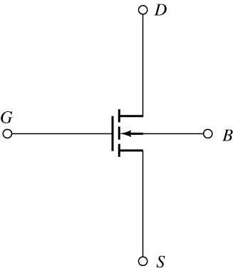
Figure: Circuit symbol for an enhancement-mode n-channel MOSFET.

Slide 26
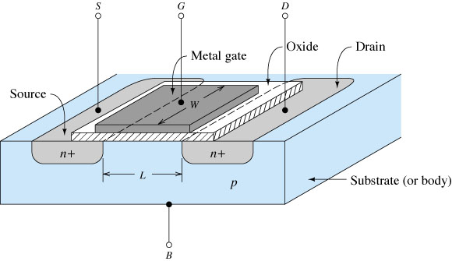
Figure: n-Channel Enhancement MOSFET showing channel length L and channel width W.

Slide 27
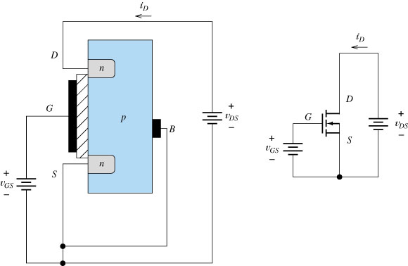
Figure: For v_{GS} < V_{to} the pn junction between drain and body is reverse biased and i_{D}=0.

Slide 28
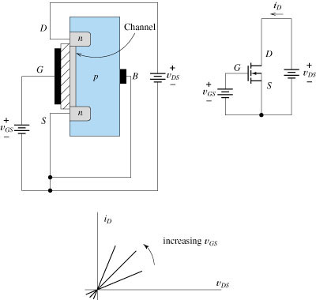
Figure: For v_{GS} >V_{to} a channel of n-type material is induced in the region under the gate.
As v_{GS} increases, the channel becomes thicker. For small values of v_{DS} ,i_{D} is proportional to v_{DS.}
The device behaves as a resistor whose value depends on v_{GS.}

Slide 29
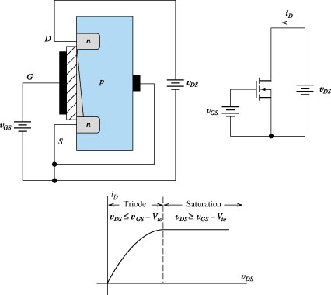
Figure: As v_{DS} increases, the channel pinches down at the drain end and i_{D} increases more slowly.
Finally for v_{DS}> v_{GS} -V_{to}, i_{D} becomes constant.

Slide 30
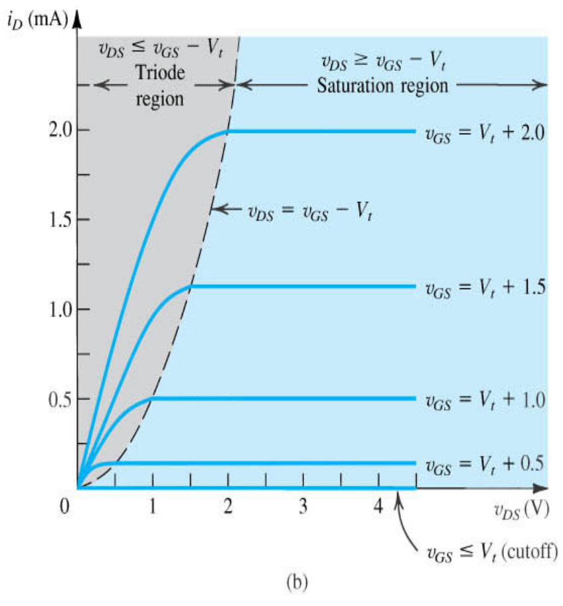
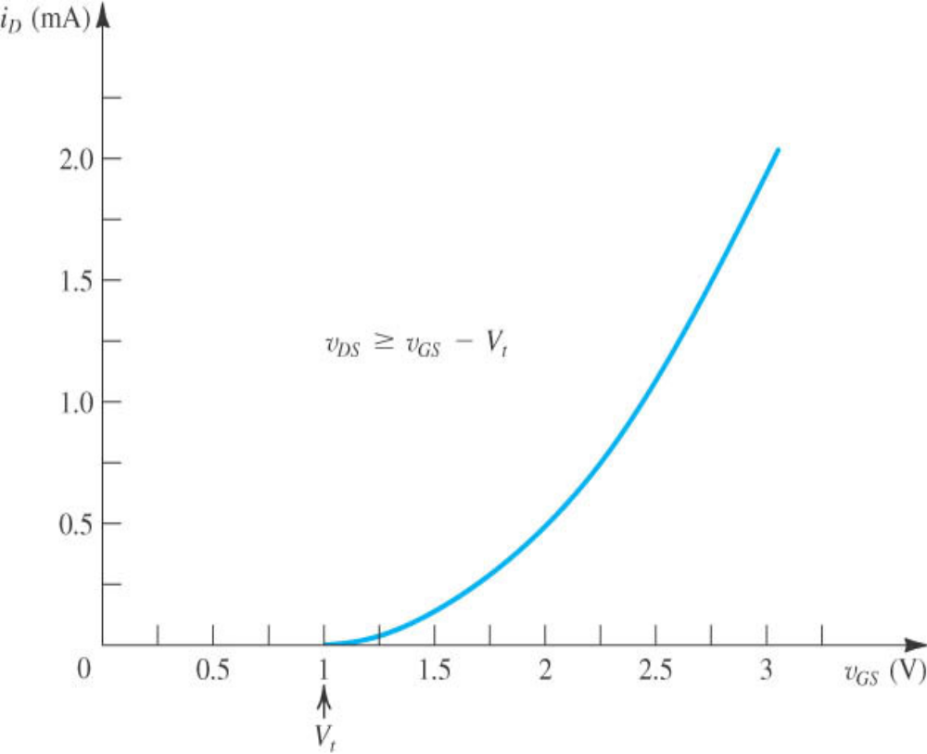
Current-Voltage Relationship of n-EMOSFET
Locus of points where

Slide 31
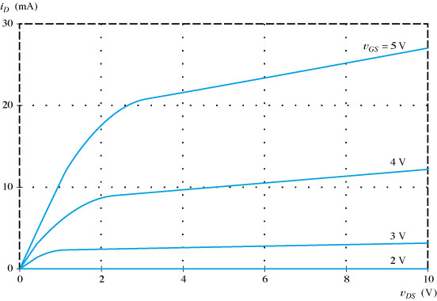
Figure: Drain characteristics

Slide 32
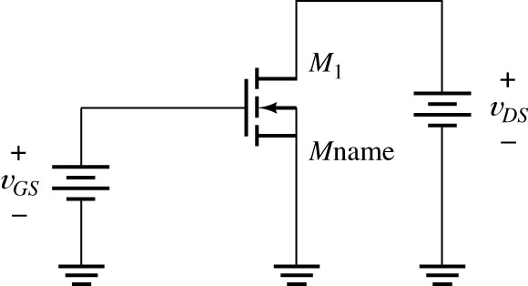
Figure: This circuit can be used to plot drain characteristics.

Slide 33
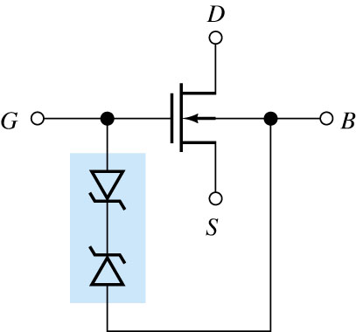
Figure: Diodes protect the oxide layer from destruction by static electric charge.

Slide 34
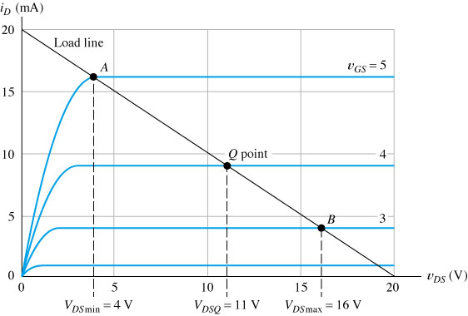
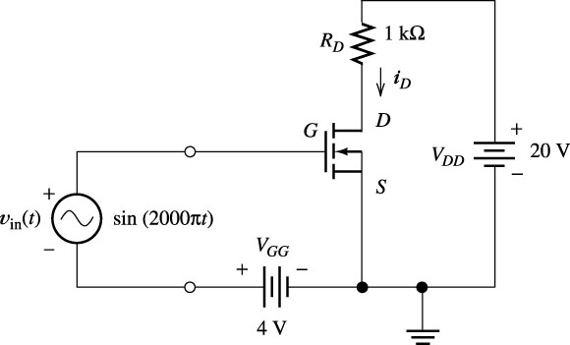
Figure: Simple NMOS amplifier circuit and Characteristics with load line.

Slide 35
Figure: Drain characteristics and load line

Slide 36
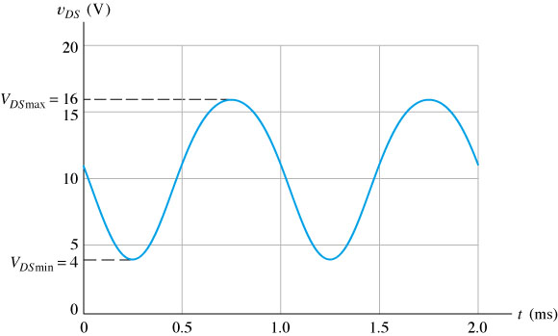
Figure v_{DS} versus time for the circuit of Figure 5.13.

Slide 37
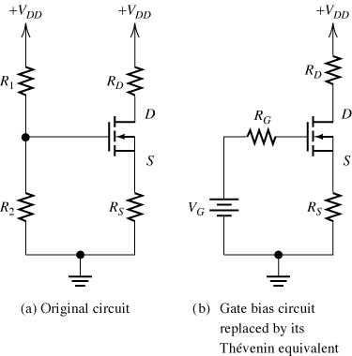
Figure Fixed- plus self-bias circuit.

Slide 38
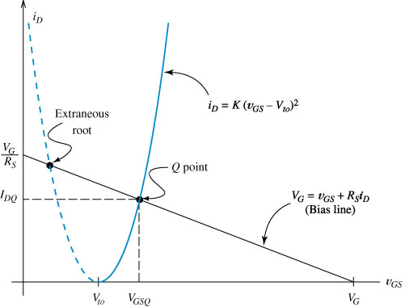
Figure Graphical solution of Equations (5.17) and (5.18).

Slide 39
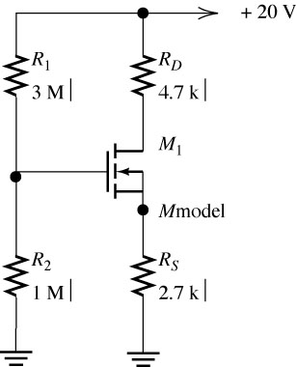
Figure Fixed- plus self-biased circuit of Example 5.3.

Slide 40

Figure The more nearly horizontal bias line results in less change in the Q-point.

Slide 41

Figure Small-signal equivalent circuit for FETs.

Slide 42

Figure FET small-signal equivalent circuit that accounts for the dependence of i_{D} on v_{DS}.

Slide 43

Figure Determination of g_{m} and r_{d}. See Example 5.5.

Slide 44

Figure Common-source amplifier.

Slide 45


For drawing an a c equivalent circuit of Amp.
Assume all Capacitors C1, C2, Cs as short circuit elements for ac signal
Short circuit the d c supply
Replace the FET by its small signal model

Slide 46





Analysis of CS Amplifier
A C Equivalent Circuit
Simplified A C Equivalent Circuit

Slide 47








Analysis of CS Amplifier with Potential Divider Bias
This is a CS amplifier configuration therefore the
input is on the gate and the output is on the drain.

Slide 48

Figure v_{o}(t) and v_{in}(t) versus time for the common-source amplifier of Figure 5.28.

Slide 49

An Amplifier Circuit using MOSFET(CS Amp.)
Figure Common-source amplifier.

Slide 50

A small signal equivalent circuit of CS Amp.
Figure Small-signal equivalent circuit for the common-source amplifier.

Slide 51
Figure v_{o}(t) and v_{in}(t) versus time for the common-source amplifier of Figure 5.28.

Slide 52

Figure Gain magnitude versus frequency for the common-source amplifier of Figure 5.28.

Slide 53

Figure Source follower.

Slide 54

Figure Small-signal ac equivalent circuit for the source follower.

Slide 55

Figure Equivalent circuit used to find the output resistance of the source follower.

Slide 56

Figure Common-gate amplifier.

Slide 57

Figure See Exercise 5.12.

Slide 58

Figure Drain current versus drain-to-source voltage for zero gate-to-source voltage.

Slide 59

Figure n-Channel depletion MOSFET.

Slide 60

Figure Characteristic curves for an NMOS transistor.

Slide 61

Figure Drain current versus v_{GS} in the saturation region for n-channel devices.

Slide 62

Figure p-Channel FET circuit symbols. These are the same as the circuit symbols for n-channel devices,
except for the directions of the arrowheads.

Slide 63

Figure Drain current versus v_{GS} for several types of FETs. i_{D} is referenced into the drain terminal
for n-channel devices and out of the drain for p-channel devices.

